Slide 1

Customer Shopping Behavior Analysis
Insights from 3,900 transactions across product categories, demographics, and shopping patterns

Slide 2

CHAPTER 1
PROJECT OVERVIEW
Project Overview
Goal
Uncover spending patterns, customer segments, product preferences, and subscription behavior.
Dataset
3,900 rows · 18 columns
Demographics, purchase details, shopping behavior
37 missing values in Review Rating

Slide 3
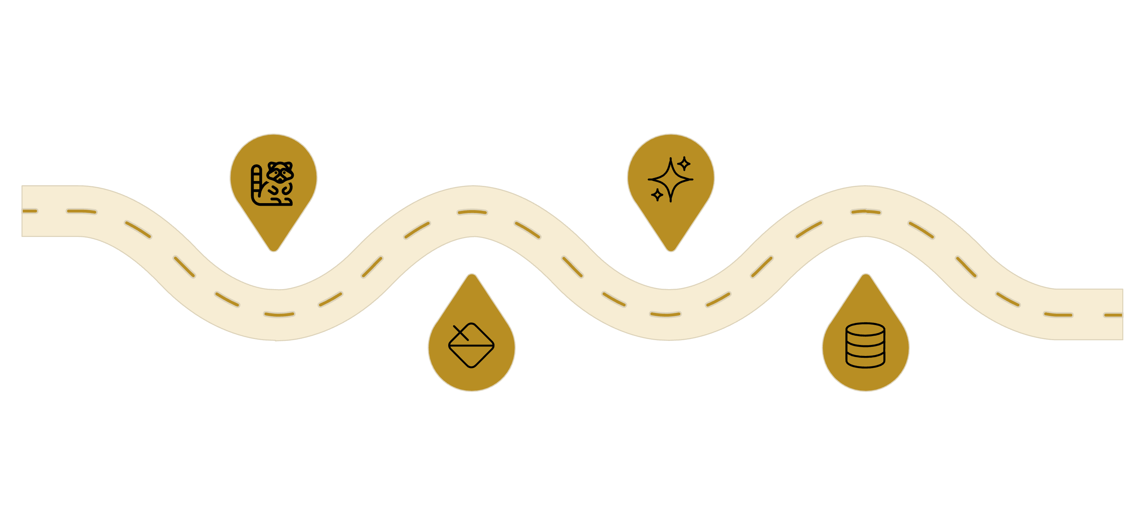

CHAPTER 2
DATA PREPARATION
Exploratory Analysis & Cleaning
Python-based pipeline from raw data to analysis-ready database
Feature Engineering
Data Loading
Load raw CSVs with pandas
Create age groups and purchase frequency
Imputation
PostgreSQL
Fill missing values by category median
Write cleaned data to PostgreSQL
Dropped redundant promo_code_used column · Renamed columns to snake_case

Slide 4
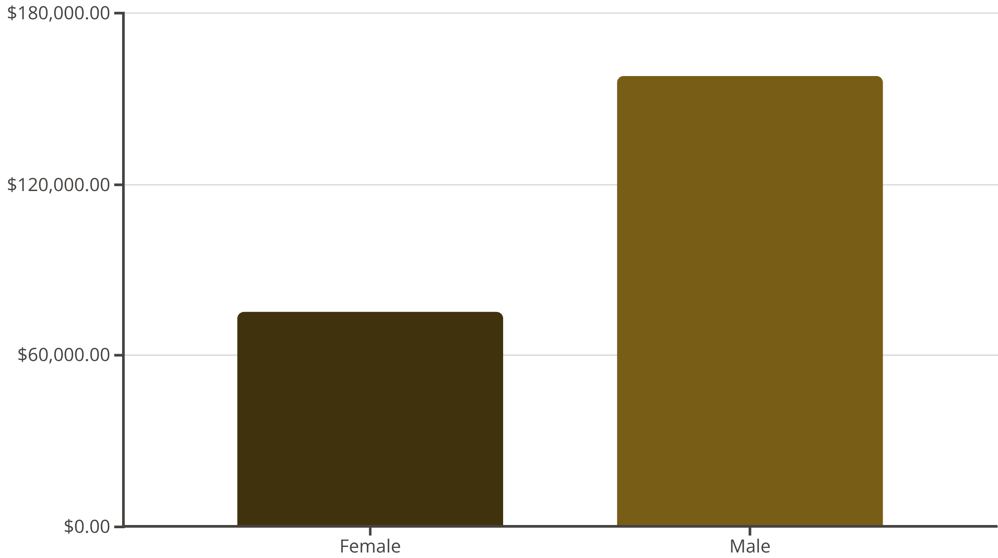
CHAPTER 3
SQL ANALYSIS
Revenue by Gender
Key Finding
Male customers generated $157,890 — more than 2× female revenue ($75,191).
839 high-spending customers still used discounts above the average purchase amount.

Slide 5

Top Products & Shipping
Top Rated
Shipping Spend
Gloves (3.86), Sandals (3.84), Boots (3.82)
Express: $60.48 avg
Standard: $58.46 avg
Discount-Heavy
Hat (50%), Sneakers (49.7%), Coat (49.1%)

Slide 6


CHAPTER 3
SUBSCRIBERS VS NON-SUBSCRIBERS
Subscription Impact
27%
73%
Subscribers
Non-Subscribers
1,053 customers · $62,645 revenue
2,847 customers · $170,436 revenue
Average spend nearly identical: $59.49 (subscribers) vs $59.87 (non-subscribers)

Slide 7
CHAPTER 3
SEGMENTATION & CATEGORIES
Customer Segments & Top Products
Segments
3,116
701
83
Loyal
Returning
New
Top 3 per Category
Category
Top Product
Orders
Clothing
Blouse
171
Accessories
Jewelry
171
Footwear
Sandals
160
Outerwear
Jacket
163

Slide 8
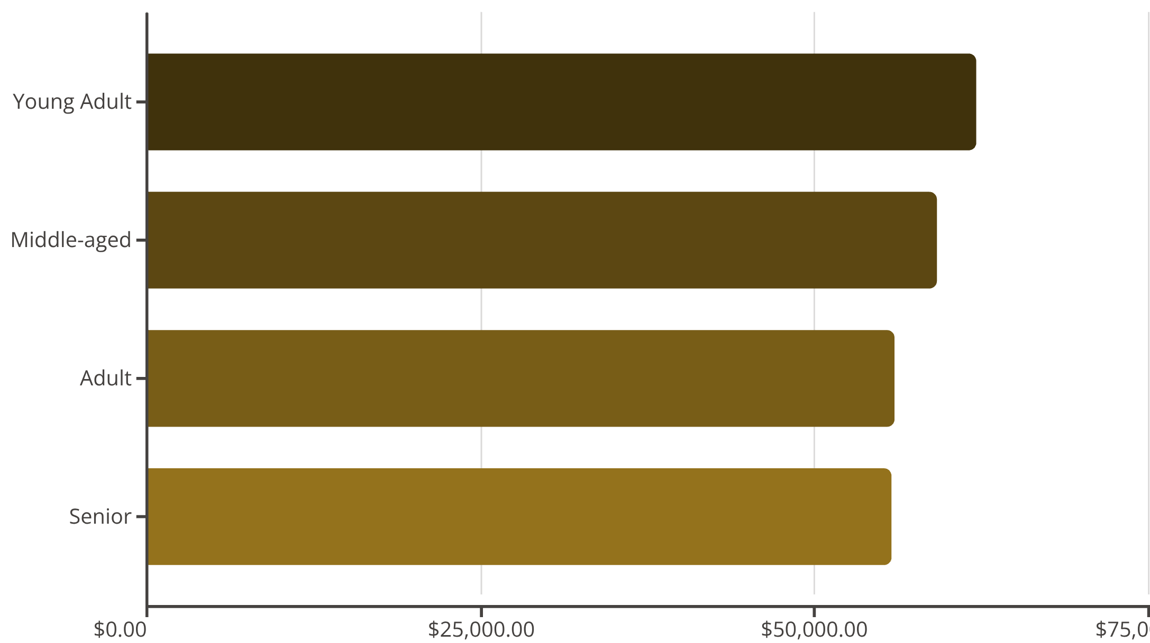
CHAPTER 3
REVENUE BREAKDOWN
Revenue by Age Group
Insight
Young Adults lead revenue at $62K. Repeat buyers: 2,518 non-subscribers vs 958 subscribers — subscription doesn't drive repeat purchases.

Slide 9
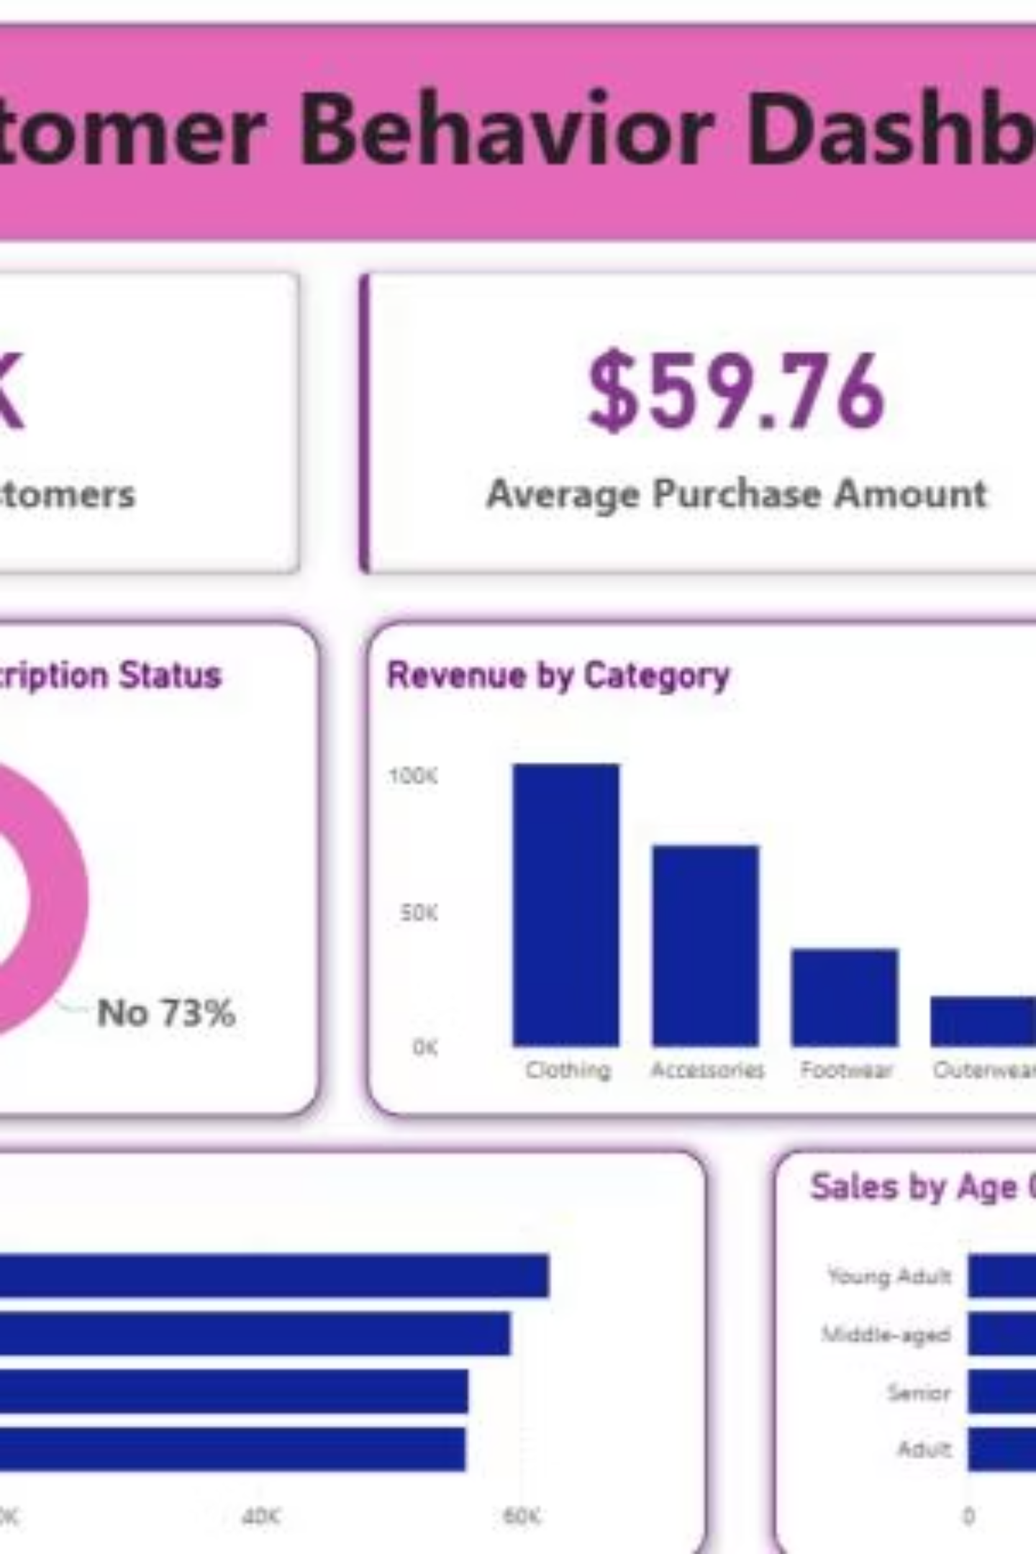
CHAPTER 4
DASHBOARD
Power BI Dashboard
3.9K
$59.76
3.75
Customers
Avg Purchase
Avg Rating

Slide 10
CHAPTER 5
RECOMMENDATIONS
Business Recommendations
Boost Subscriptions
Loyalty Programs
Review Discount Policy
Promote exclusive subscriber benefits
Reward repeat buyers into "Loyal" segment
Balance sales boosts with margin control
Product Positioning
Targeted Marketing
Highlight top-rated & best-selling items
Focus on high-revenue age groups & express users

